Slide 1


Consumer Goods Ad hoc Insights
By:- Anupam Singh

Slide 2




Contents
Company Outline
Target
About Data
Ad hoc requests
And insights

Slide 3
Our Company Outline
Atliq Hardwares is one of the leading computer hardware producers in India and well expanded in 26 other countries.
Our company produces products in 3 major categories, i.e. Peripherals & Accessories, PC, Networking & storage.
We have a total of 74 Customers like Neptune, Sage Leader, Vijay Sales, etc. to name some.

Slide 4
Target
Assist the top management team to garner more insights about the business.
Make data-driven decisions to augment company business

Slide 5
About Data
There are 4 fact tables, i.e. gross price, manufacturing cost, pre invoice deductions and sales monthly which have continuous and measurable values.
There are 2 dimension tables, i.e. customer details (dim_customers) and product details (dim_products).
For Atliq Hardware, fiscal year commences from 1st September and terminates at 31st August every year.
Sales data is available for fiscal year 2020-2021.

Slide 6
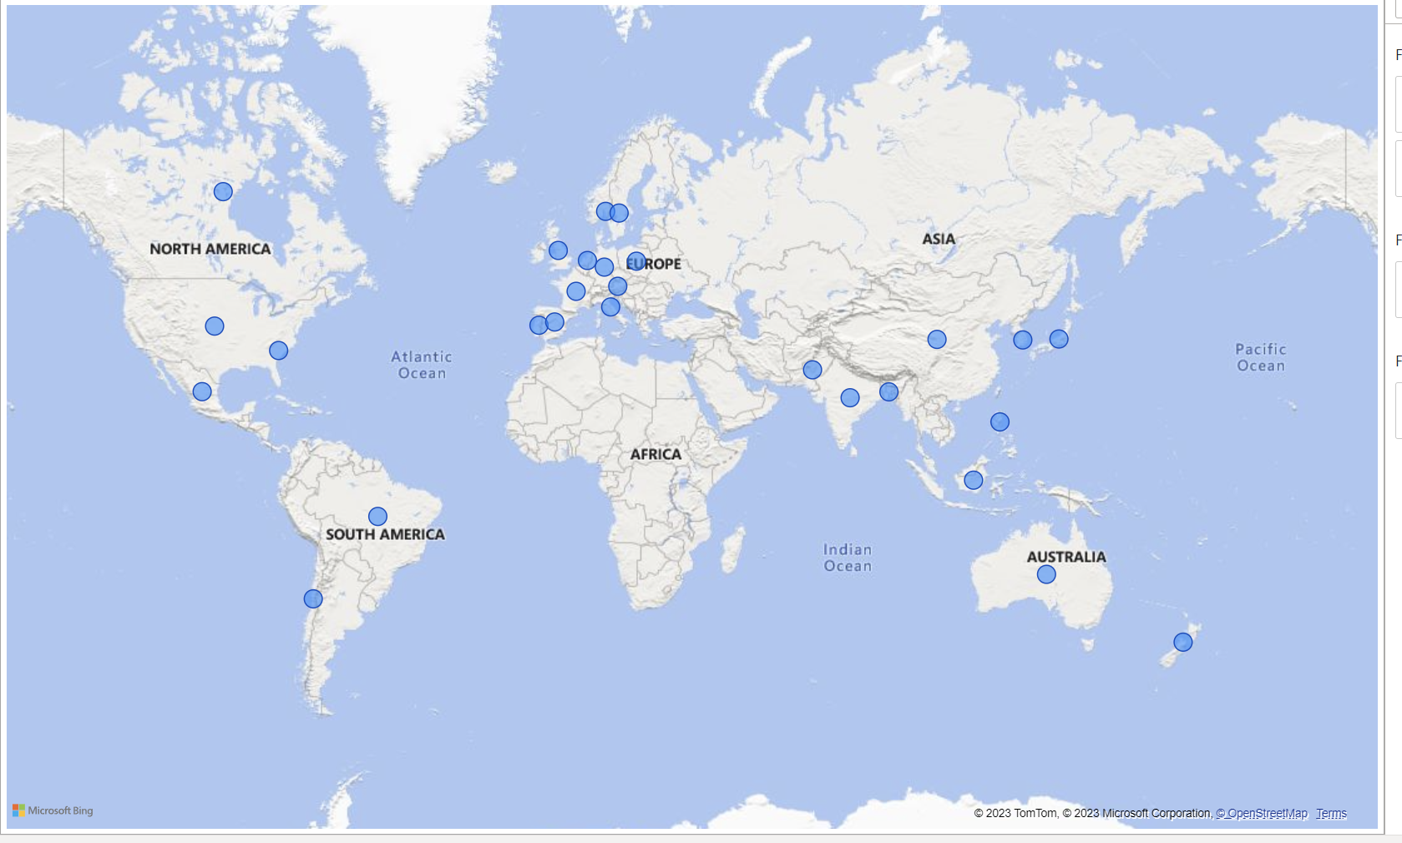
Atlique Hardwares is conducting its business in 27 countries across the globe.

Slide 7
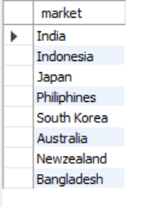
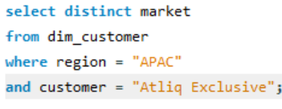
Request 1: Provide the list of markets in which customer "Atliq Exclusive" operates its business in the APAC region.
Query:
Output:

Slide 8
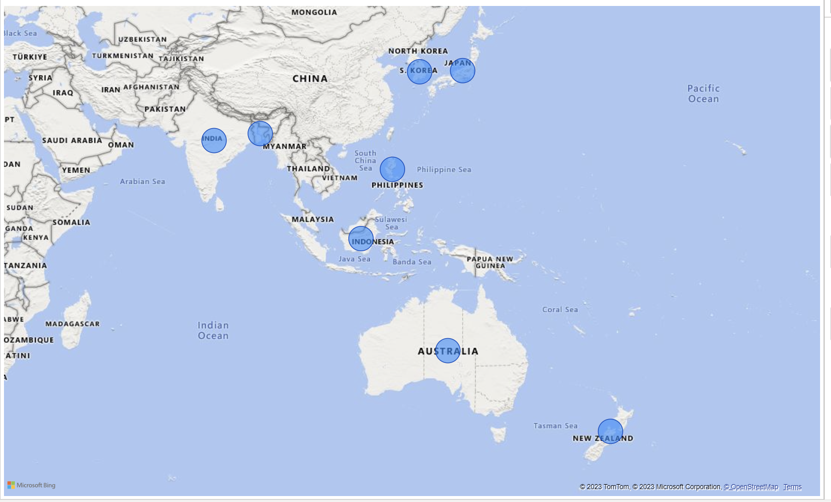
Visual and Insights
Atliq Exclusive has established its business in 8 major markets of Asia Pacific region (APAC).
It has more number of stores in APAC region followed by EU(6) and NA (2).

Slide 9
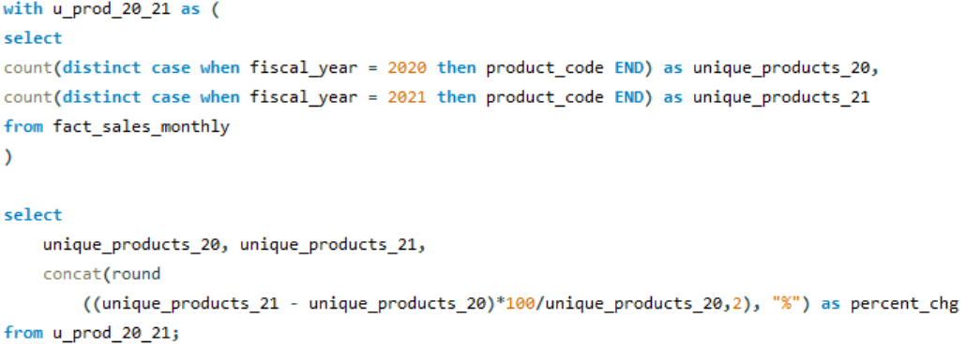
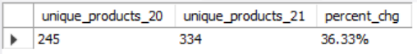
Request 2: What is the percentage of unique product increase in 2021 vs. 2020? The final output contains these fields: unique_products_2020, unique_products_2021, percentage_chg.
Query:
Output:

Slide 10
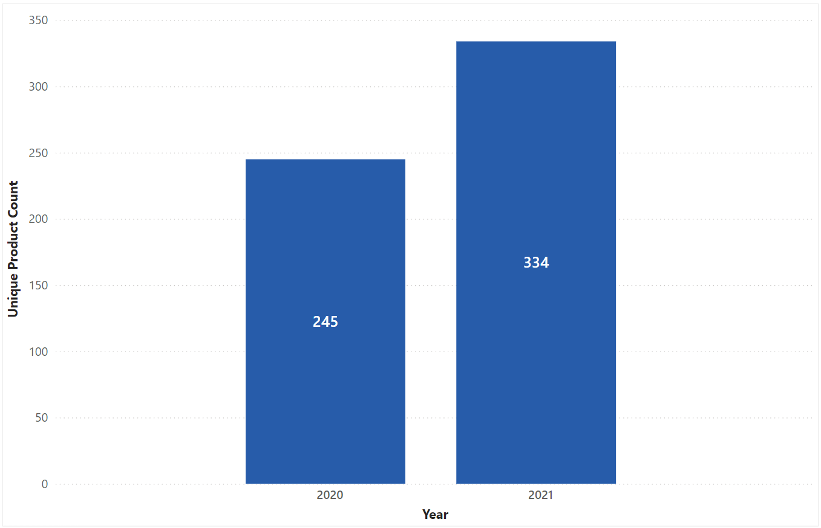
Visual and Insights
Atlique Hardwares has achieved strong reputation by keeping-up with continuously changing needs of the customer. The company has realized an increase of 36.33% in its new products.

Slide 11
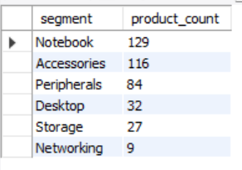
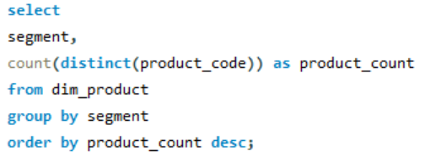
Request 3: Provide a report with all the unique product counts for each segment and sort them in descending order of product counts. The final output contains 2 fields: segment, product_count.
Query:
Output:

Slide 12
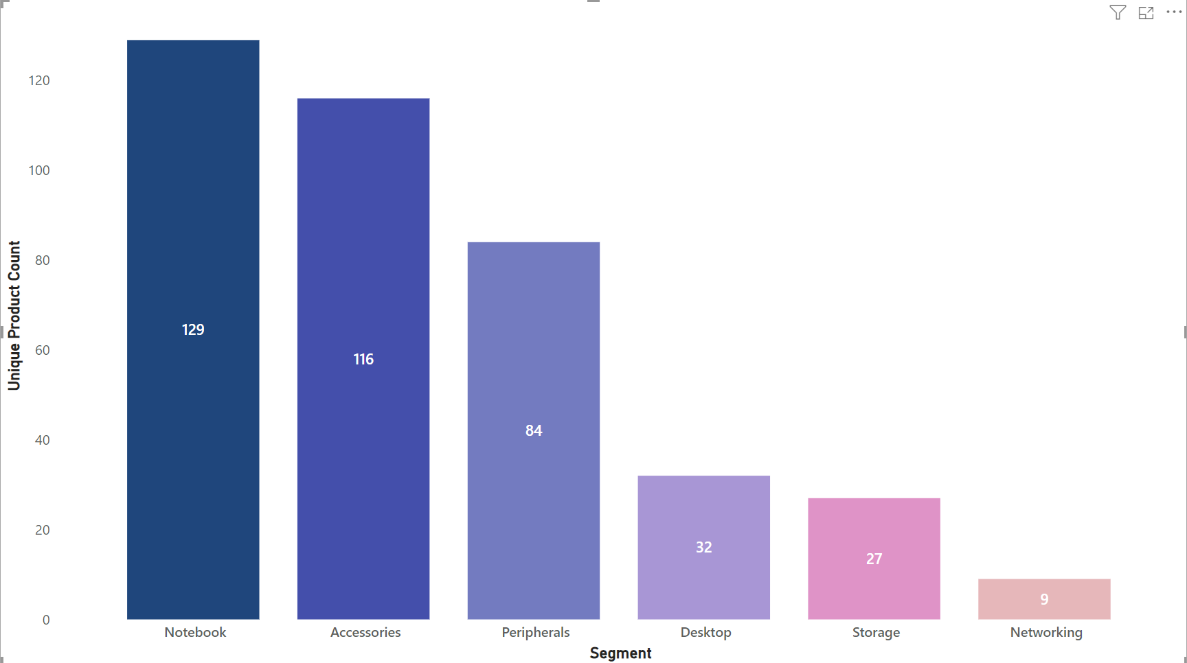
Visual and Insights
We have a gamut of products under segment: Notebook, Accessories and Peripherals averaging around 110 while segments like Desktop, Storage and Network are lagging with an average of 23 products per segment.
Product Development team must assess and evaluate products that require redesigning as per modern standards

Slide 13
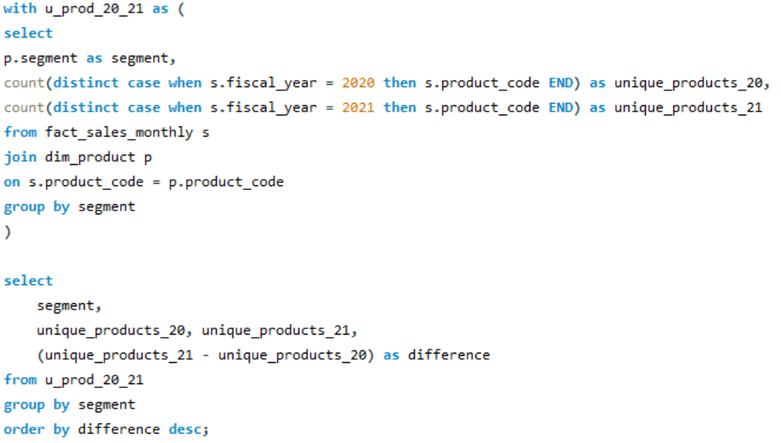
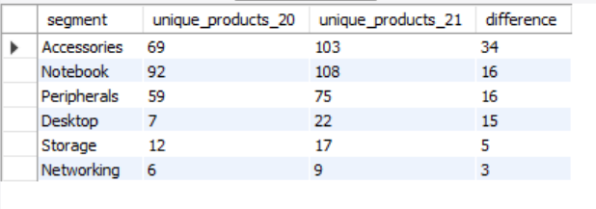
Request 4: Follow-up: Which segment had the most increase in unique products in 2021 vs 2020? The final output contains these fields: segment, product_count_2020, product_count_2021, difference.
Query:
Output:

Slide 14
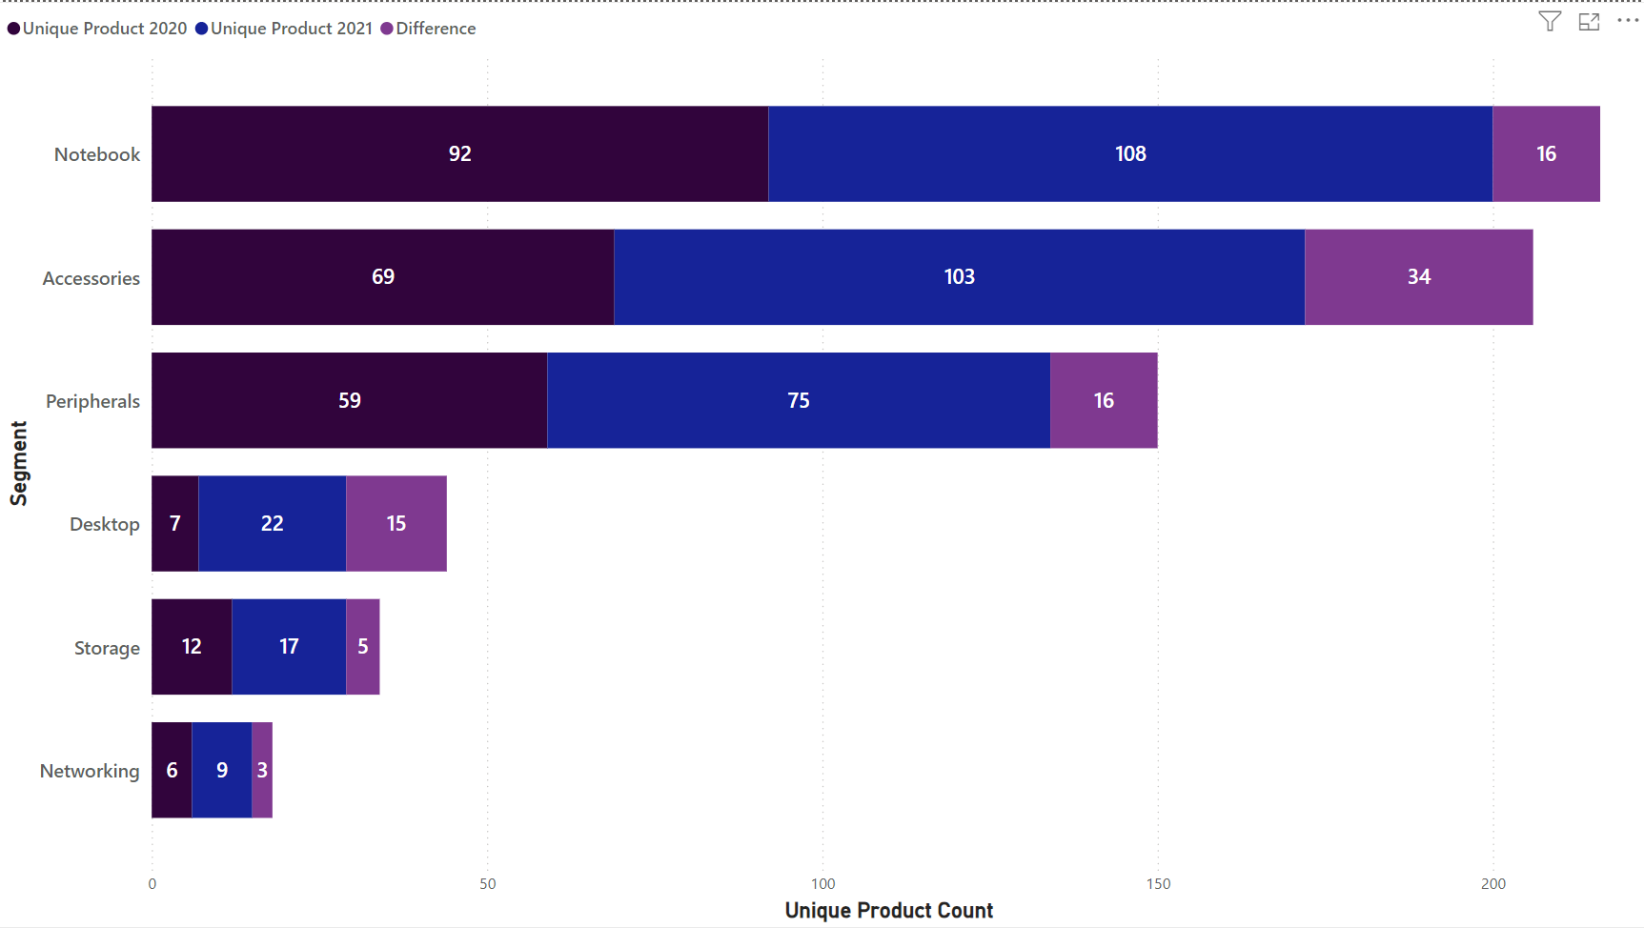
Visual and Insights
Accessories segment has highest increase in new unique product with 34 products.
Notebook & Peripherals have achieved secured 2nd position with the addition of 16 new unique products.
Desktop has obtained 3rd position with the addition of 15 in new unique products.
Storage has secured 4th last position with increase in new unique products with 5 products.
Networking has acquired bottom position with only 3 new unique products.

Slide 15
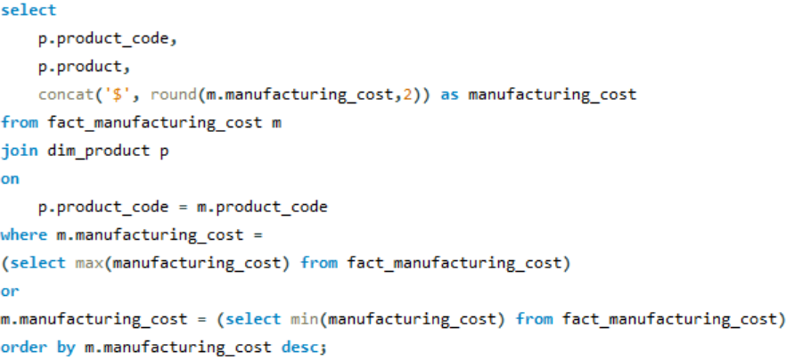
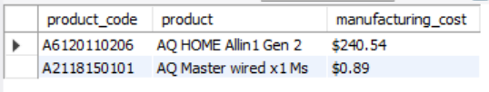
Request 5: Get the products that have the highest and lowest manufacturing costs. The final output should contain these fields: product_code, product, manufacturing_cost.
Query:
Output:

Slide 16


Visual and Insights
Highest Manufacturing Cost
Lowest Manufacturing Cost
AQ Home Allin 1 Gen 2
Category:- Personal Desktop
Cost: $240.54
AQ Master wired x1 Ms (Standard 1)
Category:- Mouse
Cost: $0.89

Slide 17
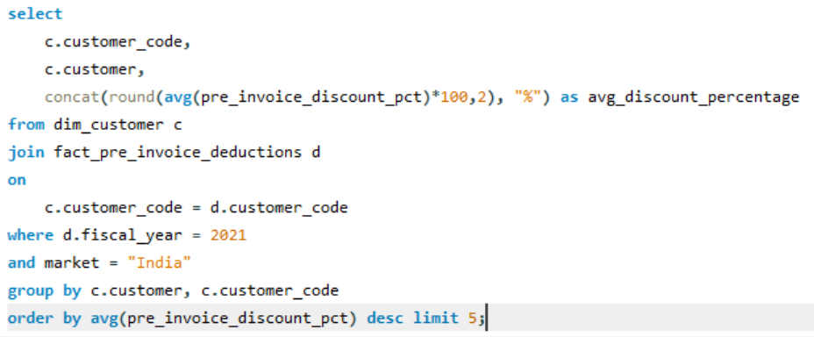
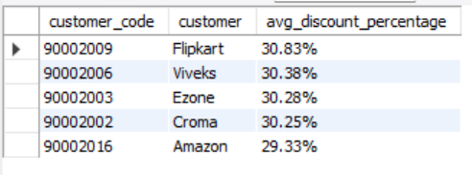
Request 6: Generate a report which contains the top 5 customers who received an average high pre_invoice_discount_pct for the fiscal year 2021 and in the Indian market. The final output contains these fields: customer_code, customer, average_discount_percentage.
Query:
Output:

Slide 18
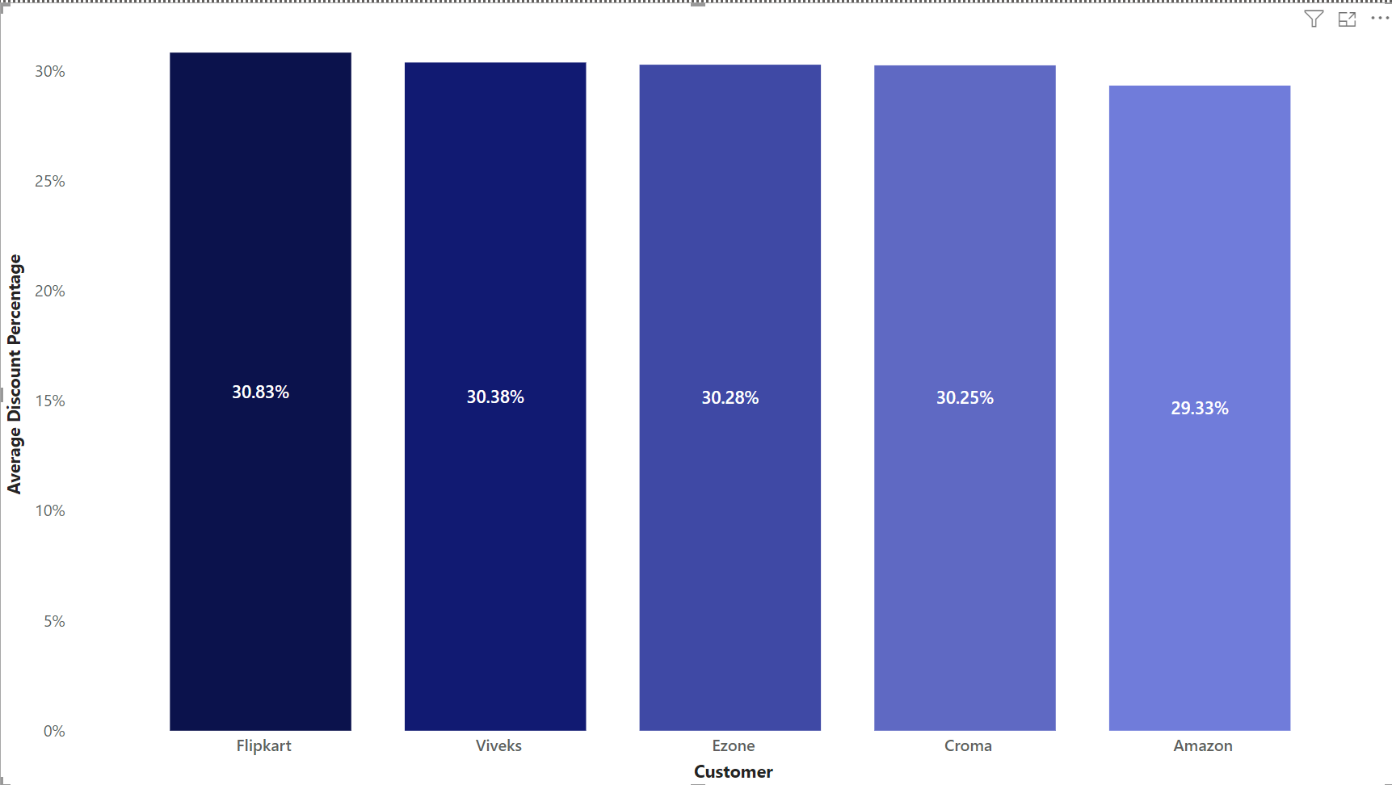
Visual and Insights
Flipkart has received the highest pre-invoice discount percent i.e. 30.83 %.
Top 5 Customers have a collective average of about 30.21%
For FY 2021, Average discount provided to all customers in Indian market was 24.16 %

Slide 19
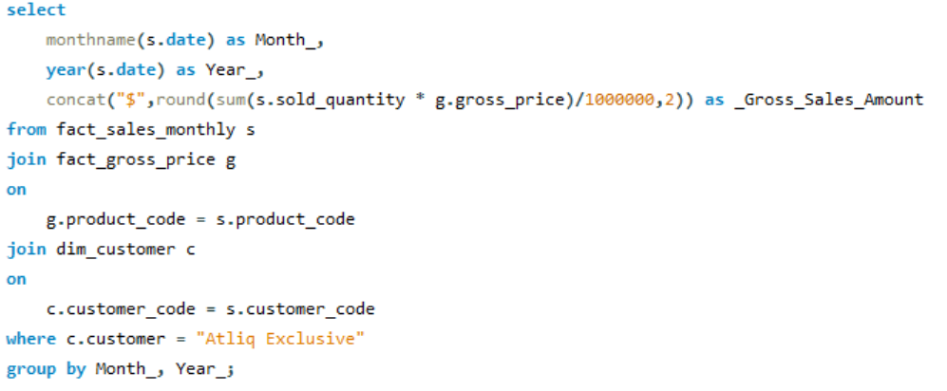
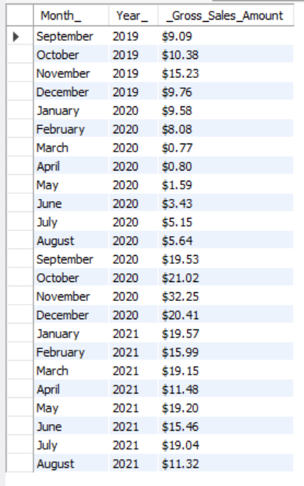
Request 7: Get the complete report of the Gross sales amount for the customer “Atliq Exclusive” for each month. This analysis helps to get an idea of low and high-performing months and take strategic decisions. The final report contains these columns: Month Year Gross sales Amount
Query:
Output:

Slide 20
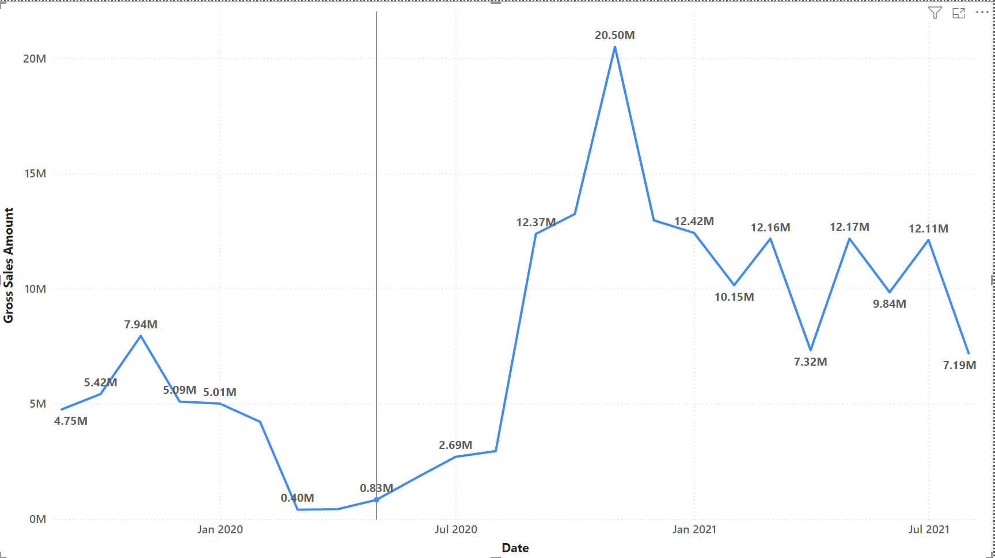
Visual and Insights
Atliq Exclusive stores’ maximum sales were recorded in November 2020 ($20.46) and lowest in the month of March 2020 ($0.38 Million).
Low sales from March to August were due to pandemic when stores outlets were closed.
From September 2020, sales began to improve due to relaxation in lockdown restrictions and the advent of festive season in India & other markets.

Slide 21
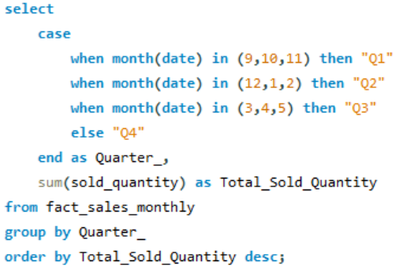
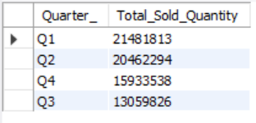
Request 8: In which quarter of 2020, got the maximum total_sold_quantity? The final output contains these fields sorted by the total_sold_quantity: Quarter, total_sold_quantity.
Query:
Output:

Slide 22
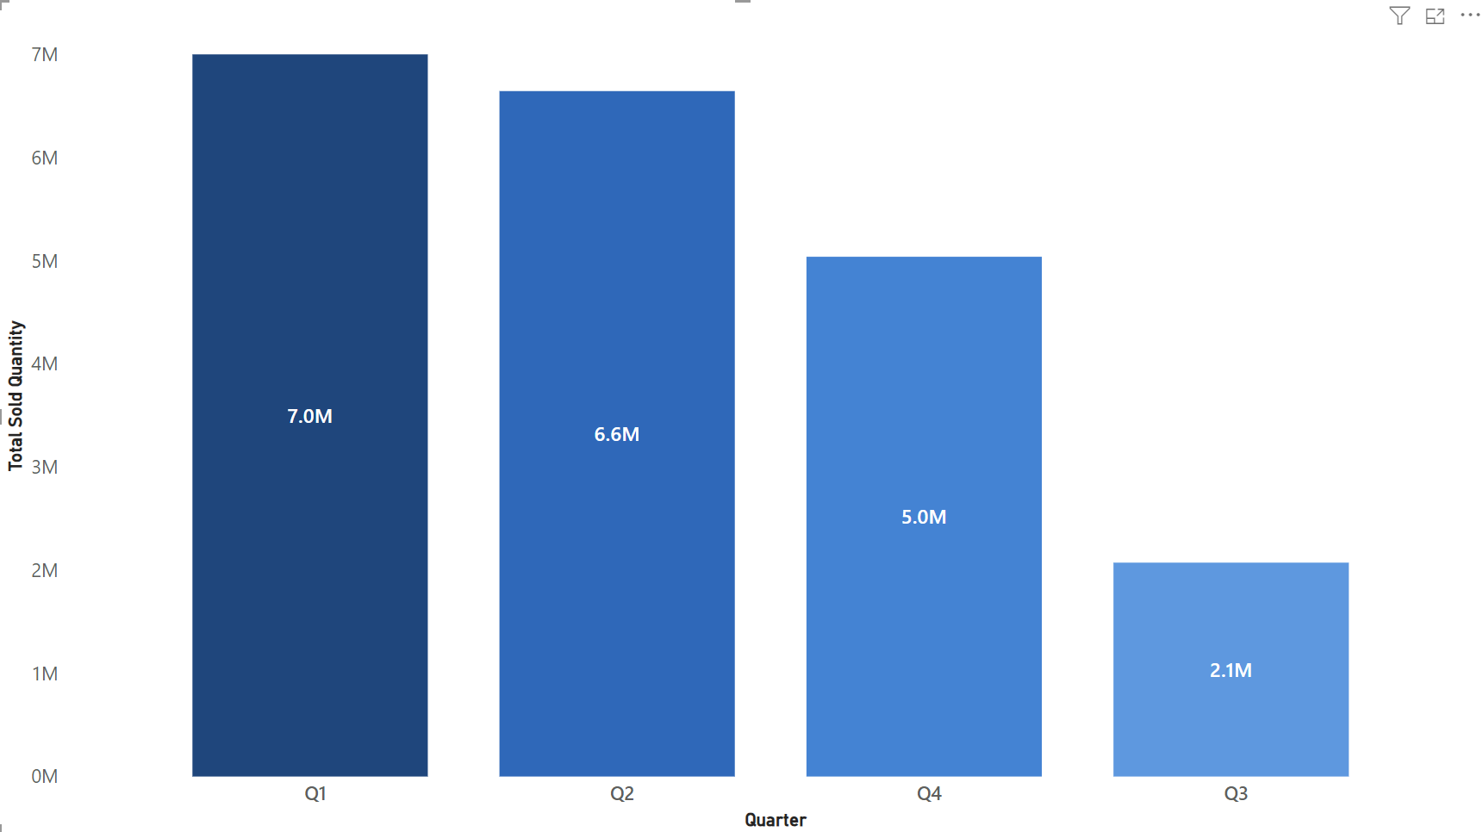
Visual and Insights
Maximum quantity sold was in quarter Q1 (September-November) for FY 2020
Sales plummeted in Q3(March-May) because of pandemic and lockdown imposition.
Quarter Q4 (June-August) projected an increase in sales.

Slide 23
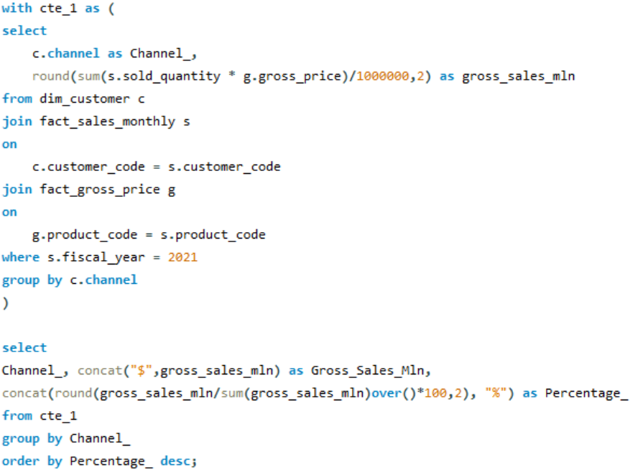
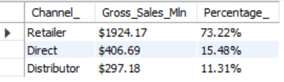
Request 9: Which channel helped to bring more gross sales in the fiscal year 2021 and the percentage of contribution? The final output contains these fields: channel, gross_sales_mln, percentage.
Query:
Output:

Slide 24
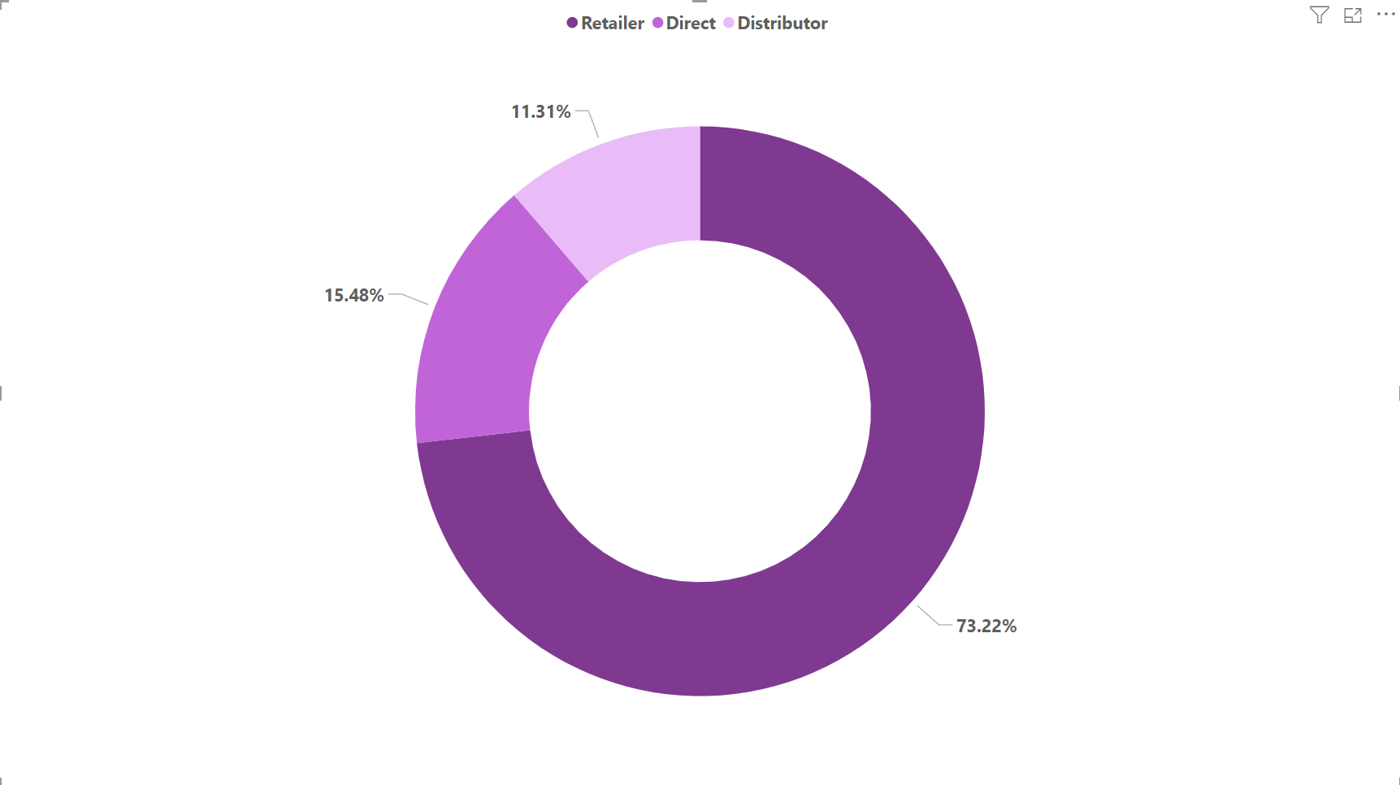
Visual and Insights
Retailers contributed the highest to the total gross sales with share percentage of 73.23% amounting to $1219.08 Million for fiscal year 2021, followed by direct channel with $257.53 Million (15.47%) and Distributor with $188.03 Million (11.29%).

Slide 25
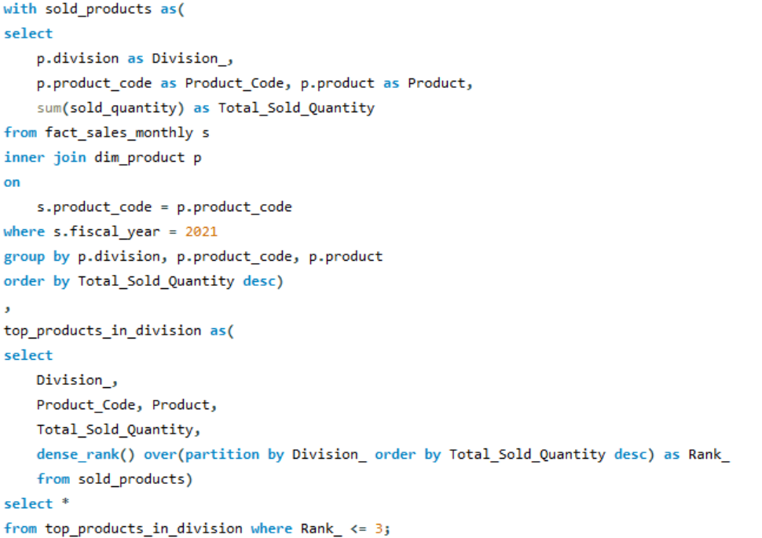
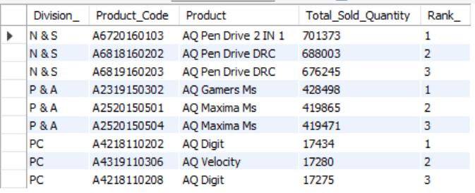
Request 10: Get the Top 3 products in each division that have a high total_sold_quantity in the fiscal_year 2021? The final output contains these fields: division, product_code, produc, total_sold_quantity, rank_order.
Query:
Output:

Slide 26
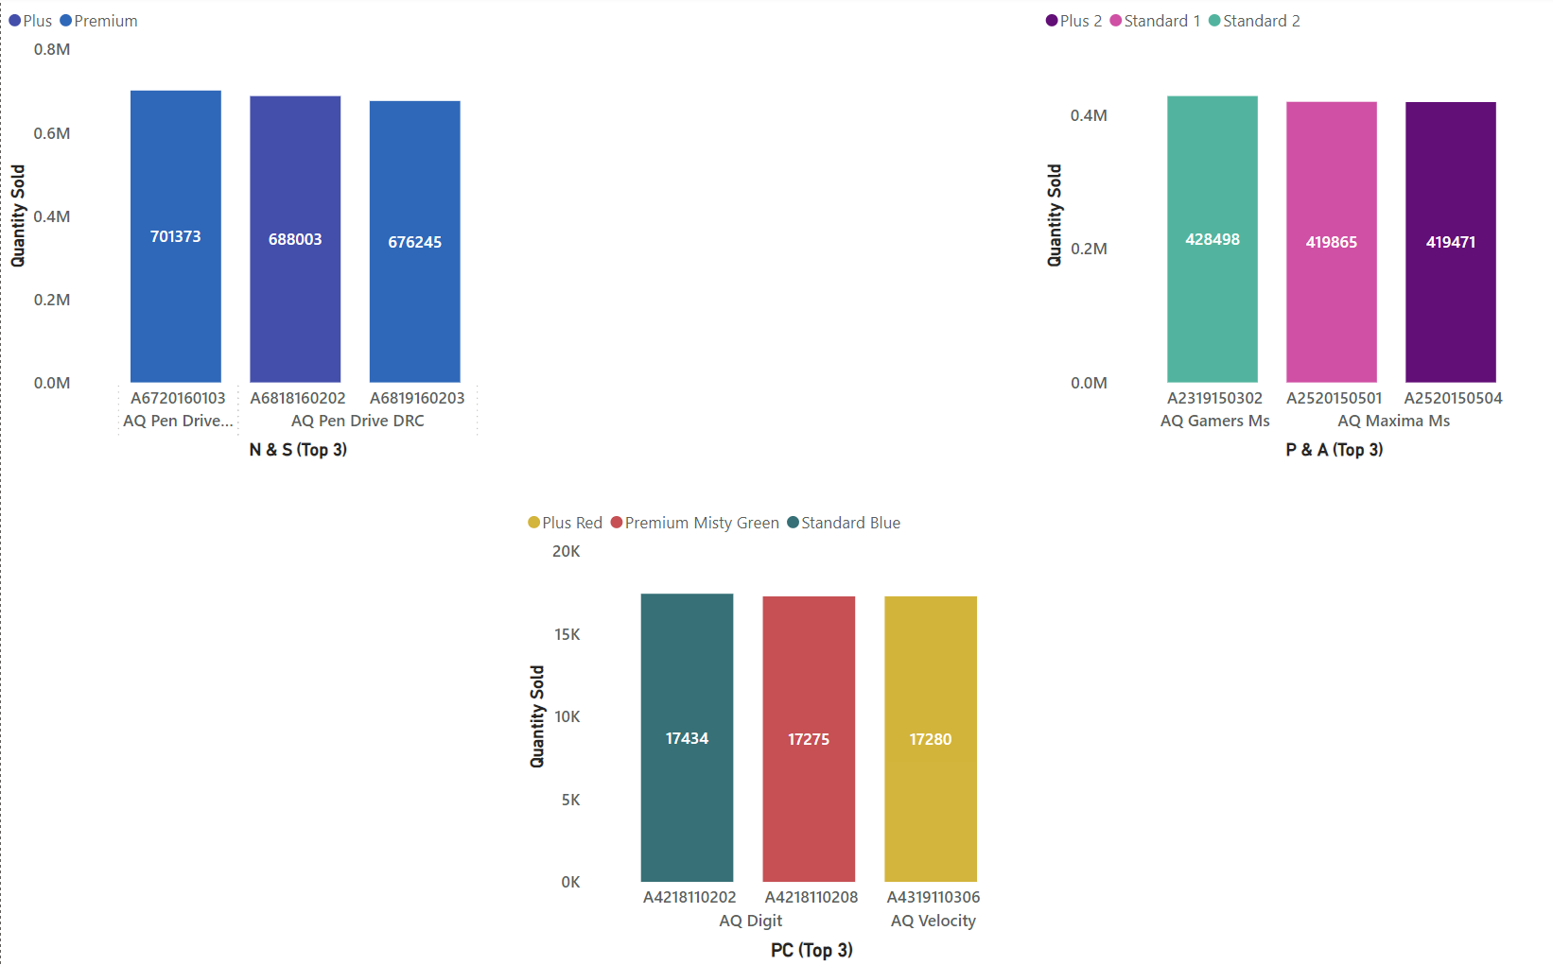
Visual and Insights
For N & S, AQ Pendrive 2 IN 1 was top selling product with a total of 7,01,373 quantities for FY 2021 followed by 2 variants of AQ Pen Drive DRC with 6,88,003 and 6,76,245 respectively.
For P & A, AQ Gamers Ms was top selling product with 4, 28, 498 quantities sold followed by 2 variants of AQ Maxima Ms.
For PC, top selling product is AQ Digit with 17,434 quantities sold
The company can take some strategic decision to improve sales in PC division.

Slide 27
Thank you

